Slide 1
Home Automation Using Packet Tracer
SUBMITTED BY
SUPERVISED BY

Slide 2
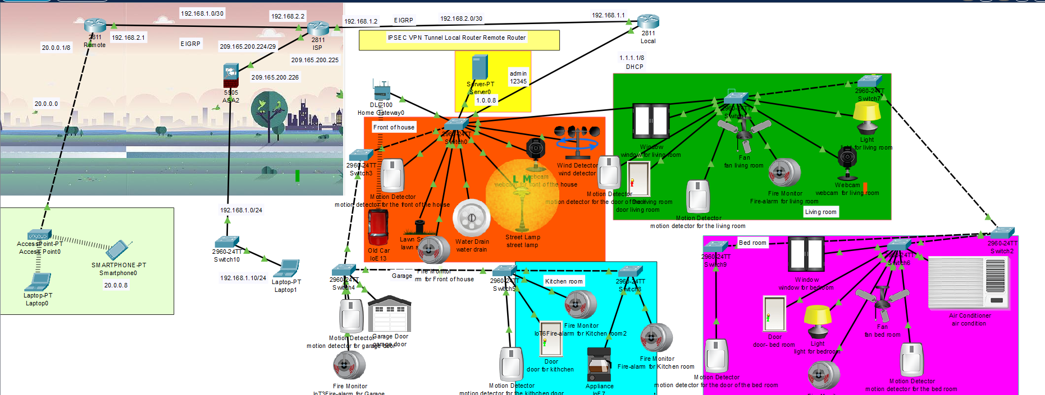
System Model

Slide 3
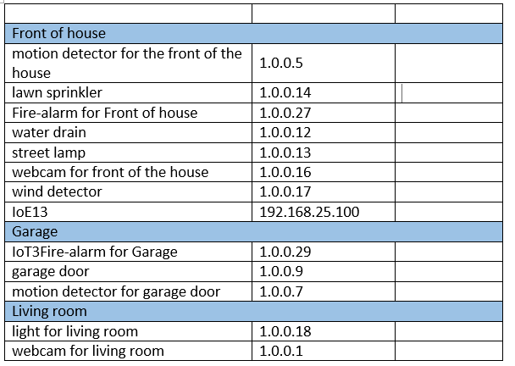
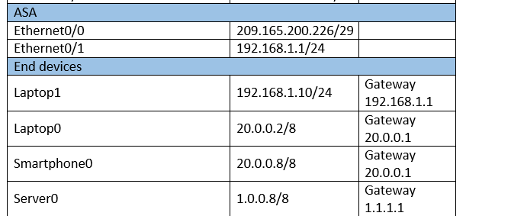
Addressing Table

Slide 4
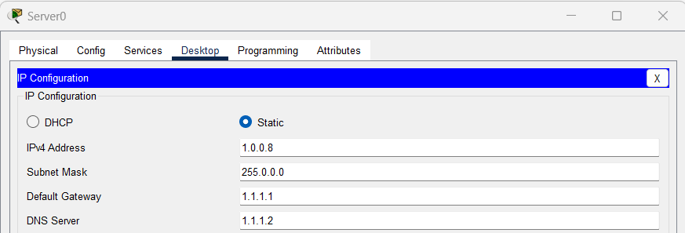
Devices configuration
IOT server

Slide 5
IOT server

Slide 6
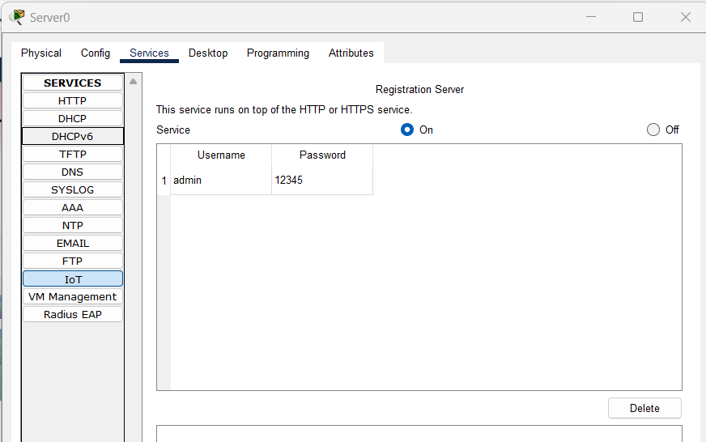
username and password for IOT server

Slide 7
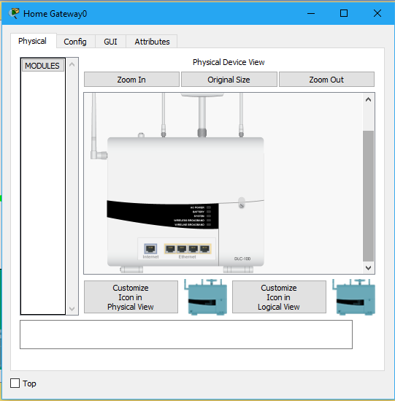
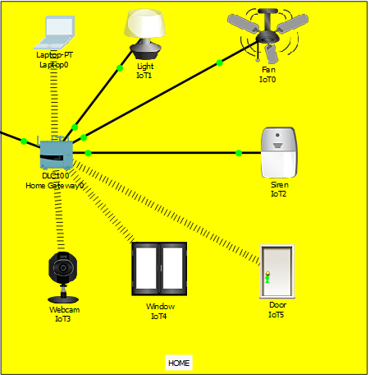
Video slide
Home gateway

Slide 8
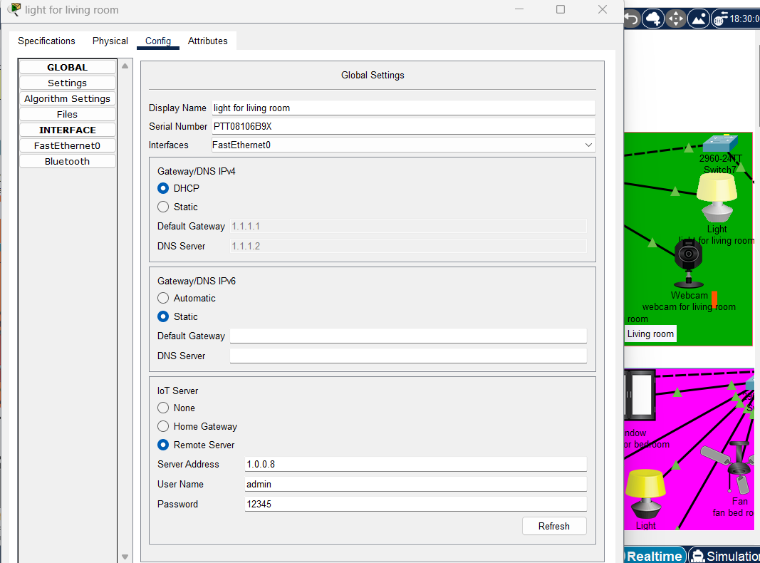
Register to IOT server

Slide 9
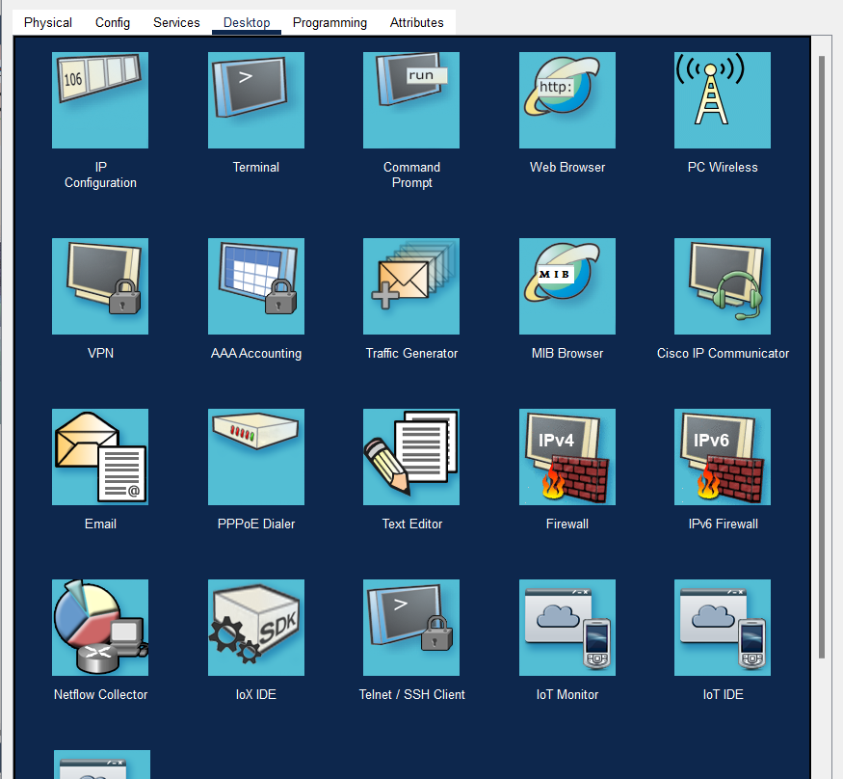
Manage IOT devices from smart phone

Slide 10
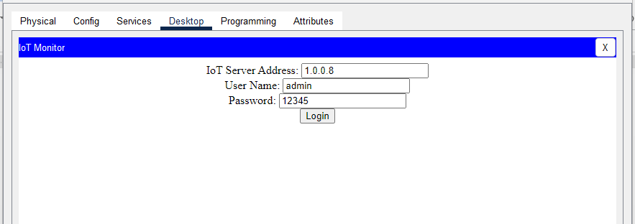
Login to IOT server
Login to server 1.0.0.8
Username admin
Password 123456

Slide 11
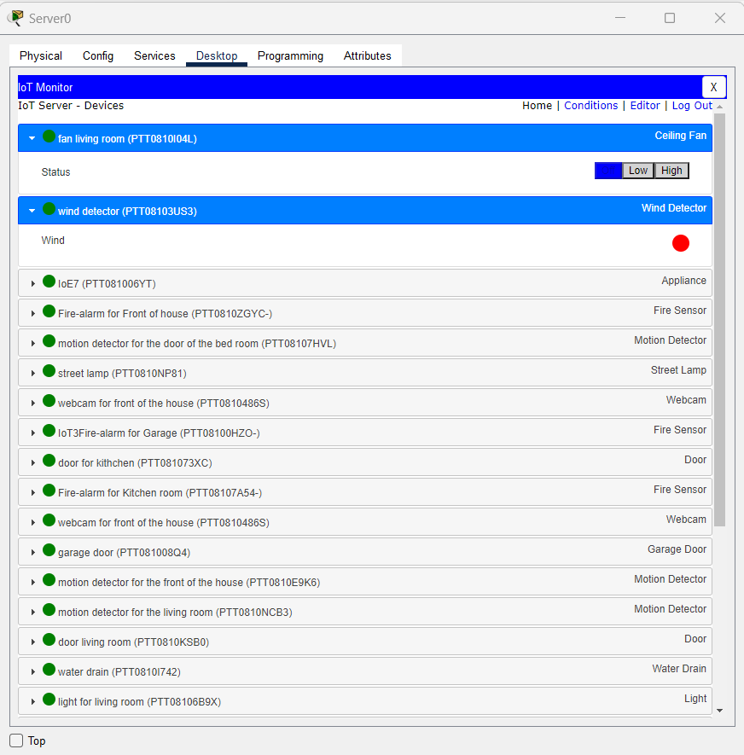
managed services

Slide 12
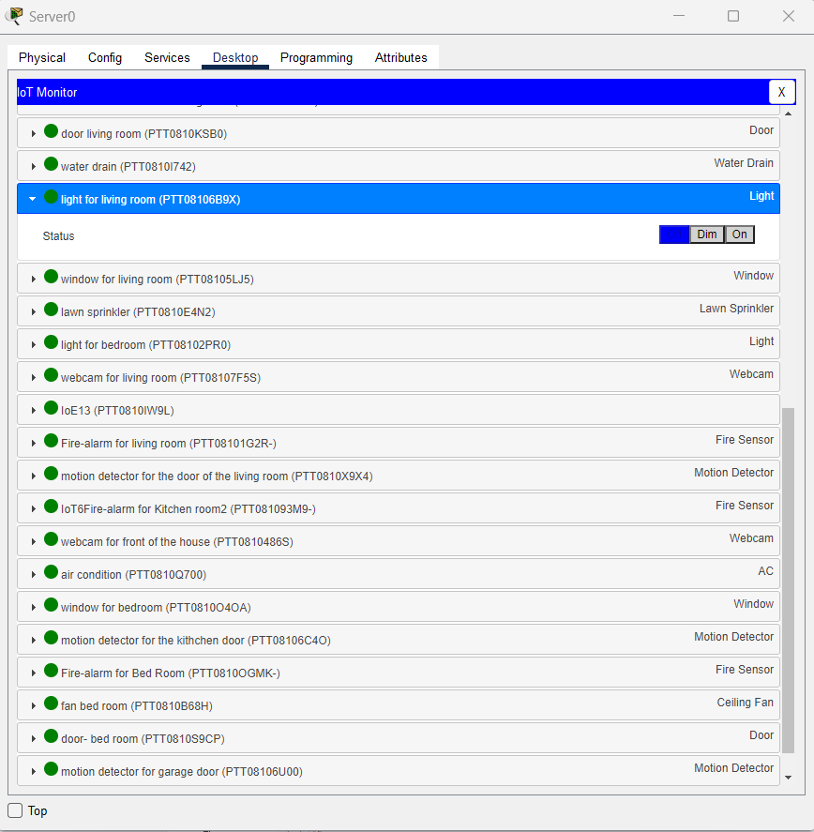
managed services

Slide 13
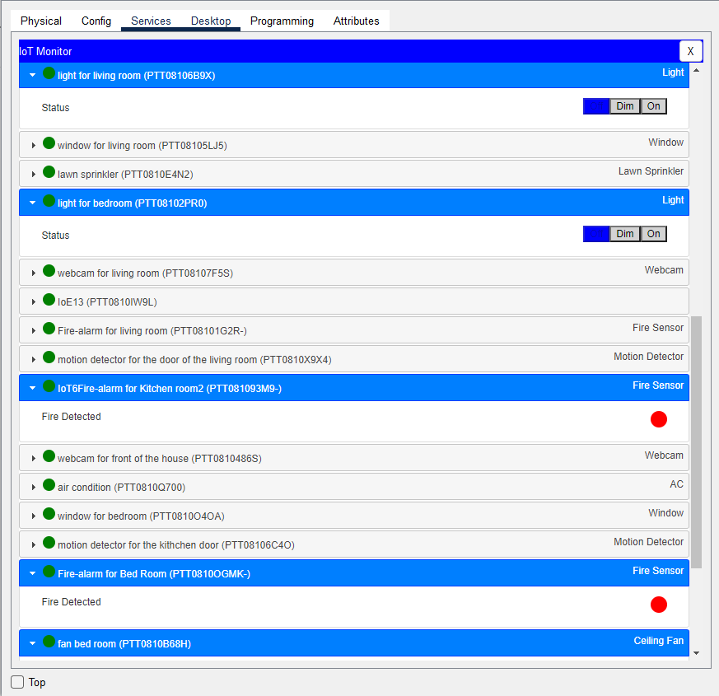
managed services

Slide 14
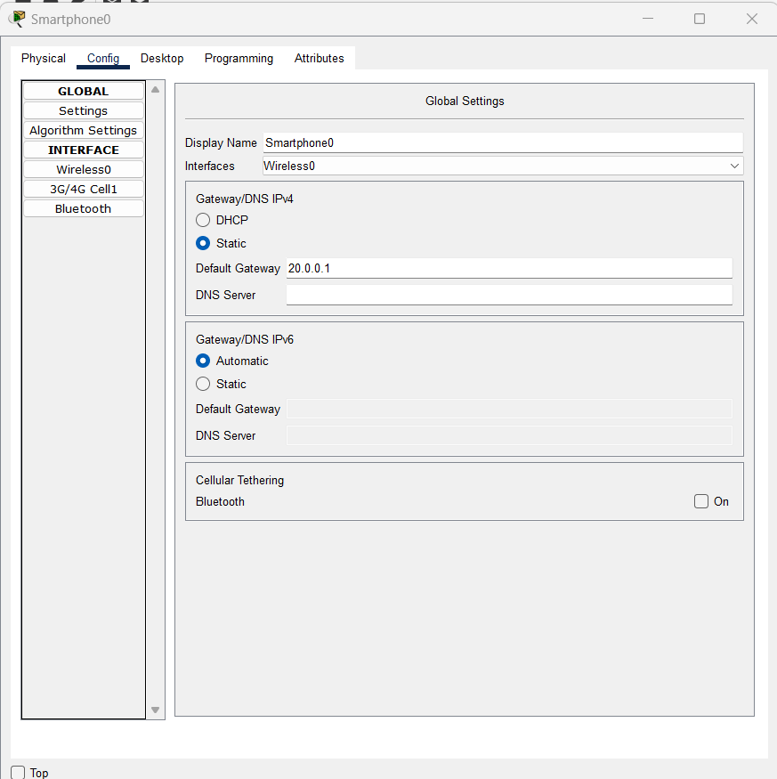
Smartphone

Slide 15
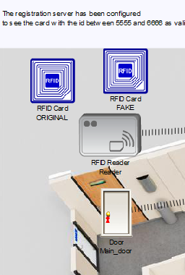
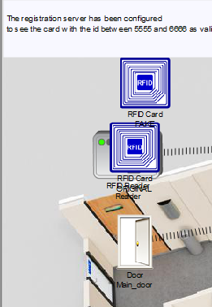
Door Lock

Slide 16
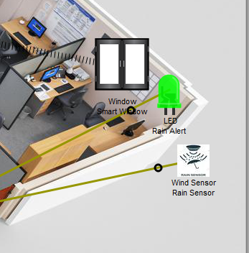
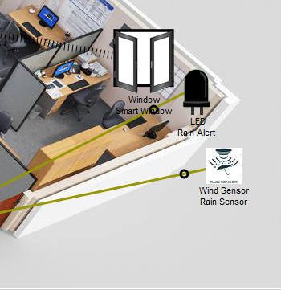
2.Smart Window

Slide 17
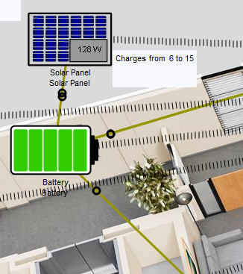
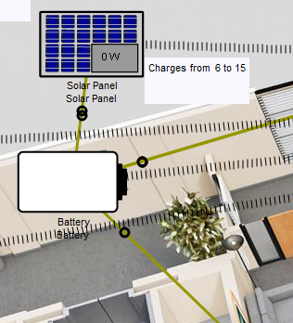
3.Solar Battery Charging

Slide 18
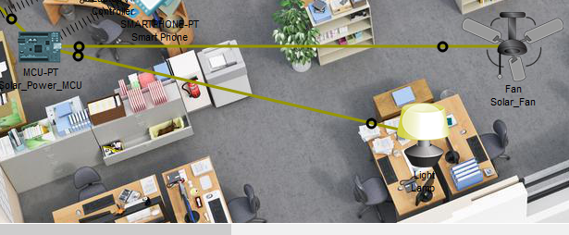
Light

Slide 19
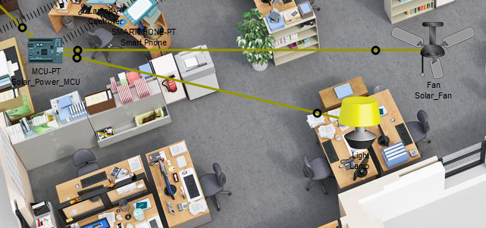
3.Solar Battery Charging

Slide 20
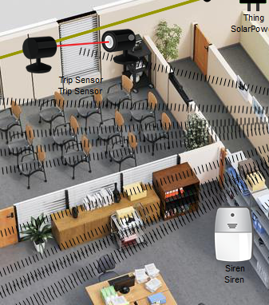
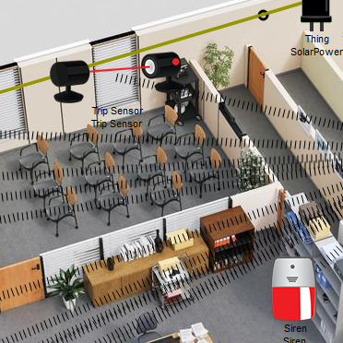
4.Anti-Theft protection

Slide 21
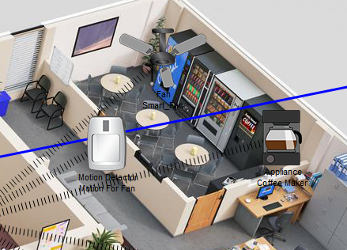
5.Auto fan and coffee maker

Slide 22
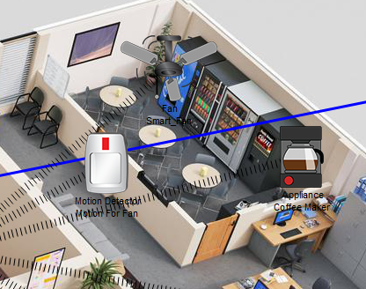
5.Auto fan and coffee maker

Slide 23
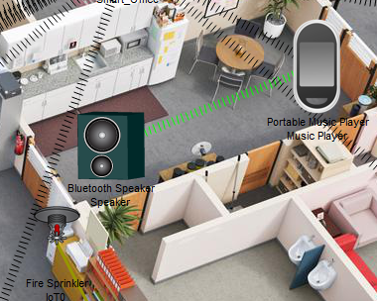
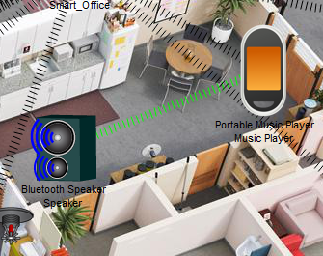
6.Music Player

Slide 24
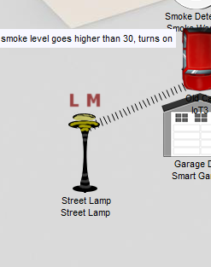
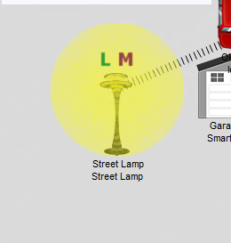
7.Smart Street Lamp

Slide 25
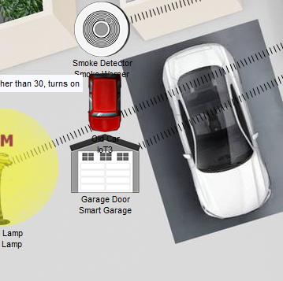
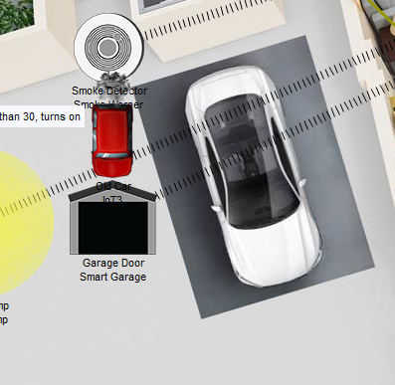
8.Smart Garage

Slide 26
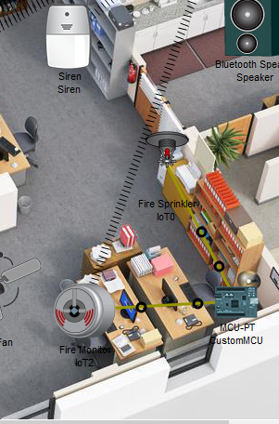
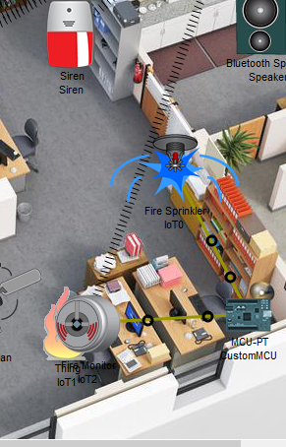
9.Fire/Smoke Alarm

Slide 27
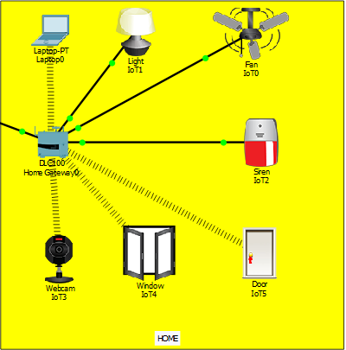
Video slide
Home gateway

Slide 28
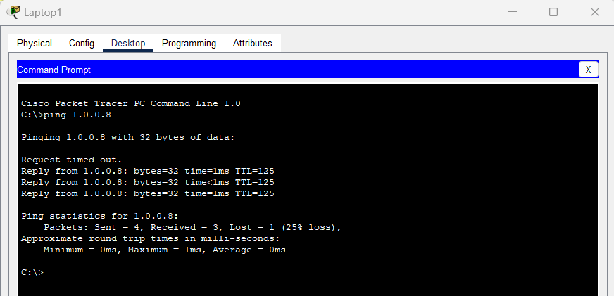
Server Reachability

Slide 29
IOT devices:
RFID Based Door Lock: Door can be unlocked only by using valid RFID card. If anyone wants to enter in the office, he or she has to show RFID. If the RFID is valid, the door will be opened, otherwise not.
Smart Window, based on light and rain: Smart Window which will be opened automatically when it’s morning time and there is no rain using rain sensor, photo sensor. If it’s night the window will be closed to avoid the mosquitoes even if there is rain.
Solar Power battery charging: Basing on solar power, fan and light will be running automatically. But, if the battery power finishes, they won’t be running. The battery only charges itself when there is sufficient light.
Anti-theft protection: To provide anti-theft protection trip sensor is being used, if anyone breaks window and enters trip sensor will give siren as alert.
Auto fan & coffee maker: When anyone enters the canteen, fan and coffee maker turns on itself detecting the motion.
Music player: Music can be played using music player via Bluetooth on a portable speaker. Entertainment purpose.

Slide 30
IOT devices:
Smart street lamp: Turns on when it’s night using photo sensor. Energy saving.
Smart garage: Opens itself when detects smoke, means the car is turned on. Either it will be entering or going out. Garage door closes itself when there is no smoke, means either car is far or it’s turned off inside the garage.
Fire alarm & smoke alarm: If anything catches fire, the fire detector will give siren to alert everyone. If ridiculous amount of smoke is generated by vehicle, smoke detector will siren alert.
RFID Based Door Lock: Door can be unlocked only by using valid RFID card. If anyone wants to enter in the office, he or she has to show RFID. If the RFID is valid, the door will be opened, otherwise not.
Smart Window, based on light and rain: Smart Window which will be opened automatically when it’s morning time and there is no rain using rain sensor, photo sensor. If it’s night the window will be closed to avoid the mosquitoes even if there is rain.

Slide 31
IOT devices:
Solar Power battery charging: Basing on solar power, fan and light will be running automatically. But, if the battery power finishes, they won’t be running. The battery only charges itself when there is sufficient light.
Anti-theft protection: To provide anti-theft protection trip sensor is being used, if anyone breaks window and enters trip sensor will give siren as alert.
Auto fan & coffee maker: When anyone enters the canteen, fan and coffee maker turns on itself detecting the motion.
Music player: Music can be played using music player via Bluetooth on a portable speaker. Entertainment purpose.
Smart street lamp: Turns on when it’s night using photo sensor. Energy saving.
Smart garage: Opens itself when detects smoke, means the car is turned on. Either it will be entering or going out. Garage door closes itself when there is no smoke, means either car is far or it’s turned off inside the garage.
Fire alarm & smoke alarm: If anything catches fire, the fire detector will give siren to alert everyone. If ridiculous amount of smoke is generated by vehicle, smoke detector will siren alert.

Slide 32
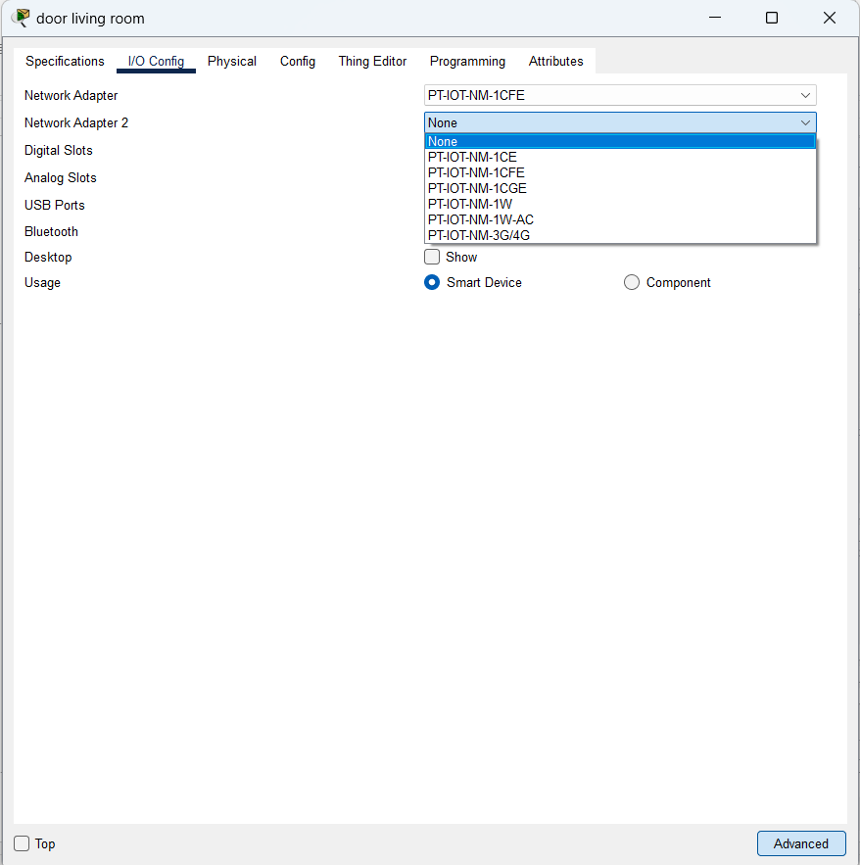
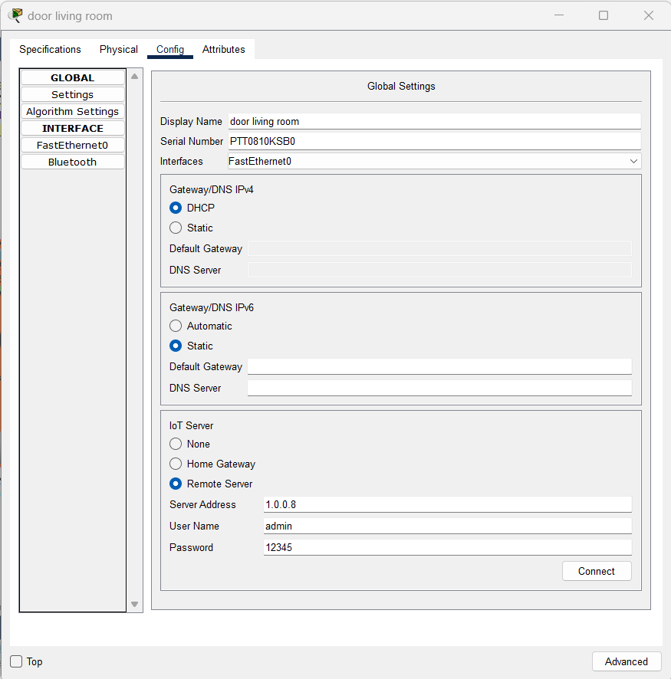
Add wired interface to IOT devices

Slide 33
Access home from Remote site

Slide 34
Enable DHCP on Router R1
R1 (config)# interface f3/0 R1 (config-if)# no shutdown R1 (config-if)# ip address 192.168.10.1 255.255.255.0 R1(config)#ip dhcp pool inside R1(dhcp-config)#network 192.168.10.0 255.255.255.0 R1(dhcp-config)#default-router 192.168.10.1 R1(dhcp-config)#domain-name learncisco.net R1(dhcp-config)#dns-server 192.168.10.89 192.168.10.90 R1 (config)# interface f1/1 R1 (config-if)# no shutdown R1 (config-if)# ip address 192.168.1.1 255.255.255.252

Slide 35
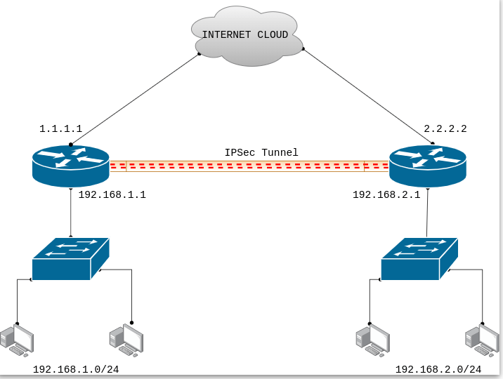
VPN (Virtual Private Network) Scenario – How to Configure IPSec VPN between Cisco Routers

Slide 36
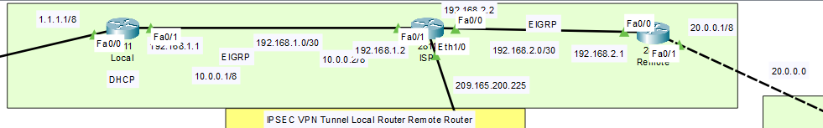
Requirements for IPSec VPN
Static Routeable IP address
Phase 1 configuration
Phase 2 configuration
Pre-Shared Key
Crypto Map and ACL Configuration

Slide 37
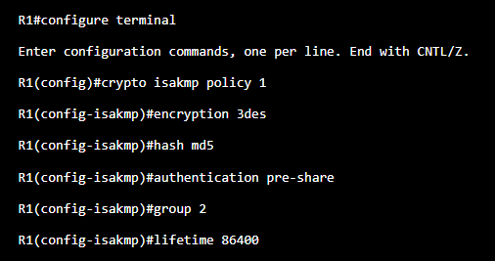
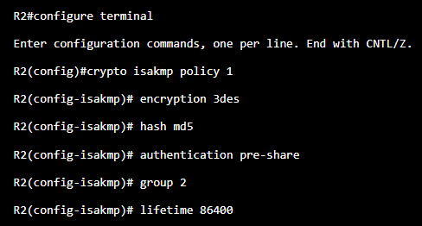
Configuring the Phase 1 on the Cisco Router R1 <> R2
Encryption: 3des (It is used to encrypt the Phase1 traffic).
Hash: md5 ( md5 is a hashing algorithm. It authenticates our data using Hash)
Group: 2 (Diffie Hellman Group 2)
Authentication: In this example, we are using the pre-shared key as authentication)
Lifetime: 86400 ( Default lifetime for the Phase1)

Slide 38
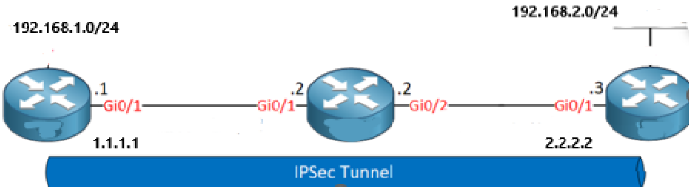
Configuring the Phase 1 on the Cisco Router R1 <> R2
Pre-Shared Key: Gns3Network
Remote Site Router IP Address: 2.2.2.2
Pre-Shared Key: Gns3Network
Remote Site Router IP Address: 1.1.1.1

Slide 39
Configuring the Phase 2 on the Cisco Router R1 <> R2
IPSec Protocol: ESP (Encapsulation Security Payload)
Encryption: 3DES
Hashing: md5

Slide 40
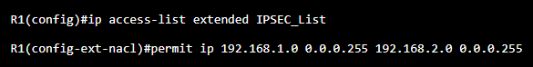
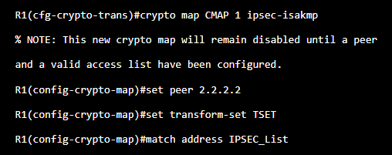
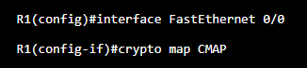
Configuring the Extended ACL and Crypto MAP

Slide 41
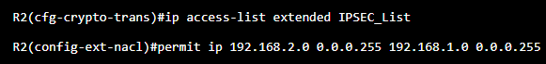
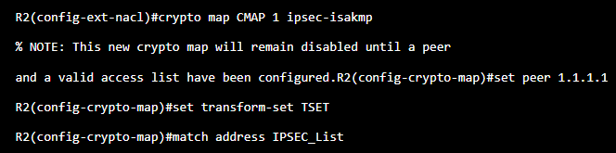
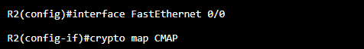
Configuring the Extended ACL and Crypto MAP

Slide 42
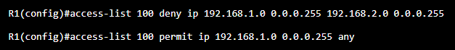



Excluding the IPSec VPN Traffic from the NAT

Slide 43

Testing the Configuration of IPSec Tunnel

Slide 44
ASA Firewall

Slide 45
! interface Vlan1 nameif inside security-level 100 ip address 192.168.1.1 255.255.255.0 interface vlan 2 ciscoasa(config-if)#ip address 209.165.200.226 255.255.255.248 ciscoasa(config-if)#route outside 0.0.0.0 0.0.0.0 209.165.200.225 object network inside-net subnet 192.168.1.0 255.255.255.0 nat (inside,outside) dynamic interface
configure t class-map inspect ciscoasa(config-cmap)#match default-inspection-traffic policy-map global_policy class map inspection_default service-policy global_policy global dhcpd address 192.168.1.10-192.168.1.30 inside dhcpd dns 8.8.8.8 interface inside dhcpd enable inside access-list inside-outside2 extended permit icmp any any access-group inside-outside2 in interface outside
ASA Firewall

Slide 46
Thanks!

